Slide 1


<Xiwen Hou>
<Nov 22, 2023>

Slide 2

Outline
Executive Summary
Introduction
Methodology
Results
Conclusion
Appendix

Slide 3
Executive Summary
Summary of methodologies
Request API to collect Data
Data Wrangling
Complete the Data Collection with Web Scraping
Complete EDA with SQL
Interactive Visual Analytics with Folium
Build an Interactive Dashboard with Ploty Dash
Machine Learning Prediction
Summary of all results
Clean the requested data
Exploratory Analysis
Interactive Visual Analytics
Predictive Analysis

Slide 4
Introduction
Project background and context
SpaceX advertises Falcon 9 rocket launches on its website, with a cost of 62 million dollars; other providers cost upward of 165 million dollars each, much of the savings is because SpaceX can reuse the first stage. Therefore if we can determine if the first stage will land, we can determine the cost of a launch. This information can be used if an alternate company wants to bid against SpaceX for a rocket launch. In this module, you will be provided with an overview of the problem and the tools you need to complete the course.
Problems you want to find answers
Why the first stage doesn’t land or crash
The cost of each launch
Predictive Analysis

Slide 5

Section 1

Slide 6
Methodology
Executive Summary
Data collection methodology:
Request and parse the SpaceX launch data using the GET request
Perform data wrangling
Perform exploratory Data Analysis and determine Training Labels
Perform exploratory data analysis (EDA) using visualization and SQL
Perform interactive visual analytics using Folium and Plotly Dash
Perform predictive analysis using classification models
How to build, tune, evaluate classification models

Slide 7
Data Collection
How Data is Collected
SpaceX launch data is collected from SpaceX REST API.
Data collection process phrases
Request and parse the SpaceX launch data using the GET request
Filter the dataframe to only include Falcon 9 launches
Dealing with Missing Values

Slide 8
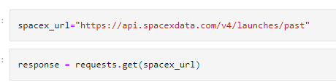
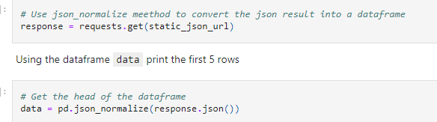
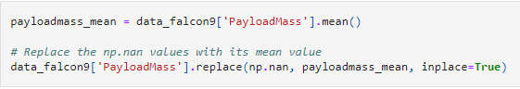
Data Collection – SpaceX API
Key phrases
Requesting launch data from SpaceX API with the URL
Decode the response content as a Json using .json() and turn it into a Pandas dataframe using .json_normalize()
Replacing missing values
SpaceX API calls notebook: https://github.com/200joyce/Capstone/blob/main/jupyter-labs-spacex-data-collection-api.ipynb

Slide 9
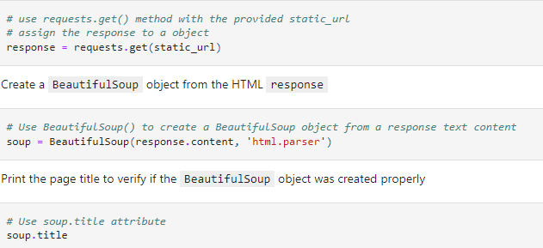
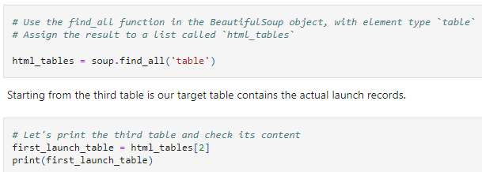
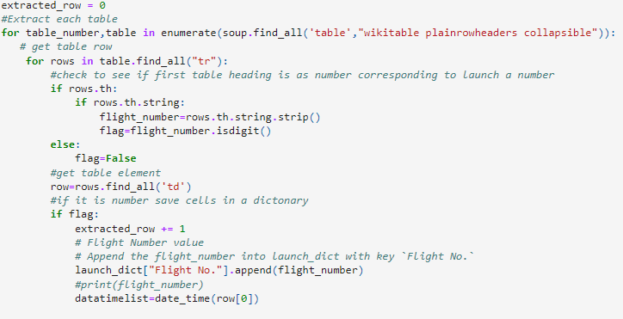
Data Collection - Scraping
key phrases:
First, perform an HTTP GET method to request the Falcon9 Launch HTML page, as an HTTP response
collect all relevant column names from the HTML table header
fill up the launch_dict with launch records extracted from table rows
GitHub URL of the completed web scraping notebook: https://github.com/200joyce/Capstone/blob/main/jupyter-labs-webscraping%20(3).ipynb

Slide 10
Data Wrangling
How data were processed:
Use the method value_counts() on the column LaunchSite to determine the number of launches on each site
Use the method .value_counts() to determine the number and occurrence of each orbit in the column Orbit
Use the method .value_counts() on the column Outcome to determine the number of landing_outcomes.Then assign it to a variable landing_outcomes
Using the Outcome, create a list where the element is zero if the corresponding row in Outcome is in the set bad_outcome; otherwise, it's one. Then assign it to the variable landing_class
GitHub URL of data wrangling: https://github.com/200joyce/Capstone/blob/main/labs-jupyter-spacex-Data%20wrangling.ipynb

Slide 11
EDA with Data Visualization
Plot out the FlightNumber vs. PayloadMassand overlay the outcome of the launch
Visualize the relationship between Flight Number and Launch Site
Visualize the relationship between Payload and Launch Site
Visualize the relationship between success rate of each orbit type
Visualize the relationship between FlightNumber and Orbit type
Visualize the relationship between Payload and Orbit type
Visualize the launch success yearly trend
The GitHub URL of EDA with data visualization notebook: https://github.com/200joyce/Capstone/blob/main/jupyter-labs-eda-dataviz.ipynb.jupyterlite_ExploringAndPreparingData_wk2.ipynb

Slide 12
EDA with SQL
Using bullet point format, summarize the SQL queries you performed
Display the names of the unique launch sites in the space mission
Display 5 records where launch sites begin with the string 'CCA‘
Display the total payload mass carried by boosters launched by NASA (CRS)
Display average payload mass carried by booster version F9 v1.1
List the date when the first successful landing outcome in ground pad was achieved.
List the names of the boosters which have success in drone ship and have payload mass greater than 4000 but less than 6000
List the total number of successful and failure mission outcomes
List the names of the booster_versions which have carried the maximum payload mass. Use a subquery
List the records which will display the month names, failure landing_outcomes in drone ship ,booster versions, launch_site for the months in year 2015
Rank the count of landing outcomes (such as Failure (drone ship) or Success (ground pad)) between the date 2010-06-04 and 2017-03-20, in descending order.
GitHub URL of EDA with SQL notebook: https://github.com/200joyce/Capstone/blob/main/jupyter-labs-eda-sql-coursera_sqllite_wk2_2.ipynb

Slide 13
Build an Interactive Map with Folium
Summarize what map objects such as markers, circles, lines, etc. you created and added to a folium map
first need to create a folium Map object, with an initial center location to be NASA Johnson Space Center at Houston, Texas
use folium.Circle to add a highlighted circle area with a text label on a specific coordinate
Create markers for al launch records, will mark if the launch was successful or not
Draw a PolyLine between a launch site to the selected coastline point, so you can draw a line betwee a launch site to its closest city, railway, highway.
GitHub URL of interactive map with Folium map: https://github.com/200joyce/Capstone/blob/main/lab_jupyter_launch_site_location.jupyterlite_wk3_1_FoliumLab.ipynb

Slide 14
Build a Dashboard with Plotly Dash
Build an interactive Dashboard Application with Plotly Dash
Add a Launch Site Drop-down Input Component
Add a callback function to render success-pie-chart based on selected site dropdown
Add a Range Slider to Select Payload
Add a callback function to render the success-payload-scatter-chart scatter plot
The pie charts shows the total percentage of launches by each site
The plotted scatter graph shows the relationship with Outcome and
The scatter graph shows the relationship with each site and Payload Mass (Kg)
The GitHub URL of Plotly Dash lab: https://github.com/200joyce/Capstone/blob/main/spacex_dash_app_WithPlotlyDash.py

Slide 15
Predictive Analysis (Classification)
Perform exploratory Data Analysis and determine Training Labels
Find best Hyperparameter for SVM, Classification Trees and Logistic Regression
Find the method performs best using test data
Create a NumPy array from the column Class in data
Standardize the data
Create a logistic regression object, and calculate the accuracy on the test data
Create a support vector machine object
Create a decision tree classifier object
Create a k nearest neighbors object
The GitHub URL of predictive analysis lab: https://github.com/200joyce/Capstone/blob/main/SpaceX_Machine_Learning_Prediction_Part_5.jupyterlite_2.ipynb

Slide 16
Results
Exploratory data analysis results
Interactive analytics demo in screenshots
Predictive analysis results

Slide 17

Section 2

Slide 18
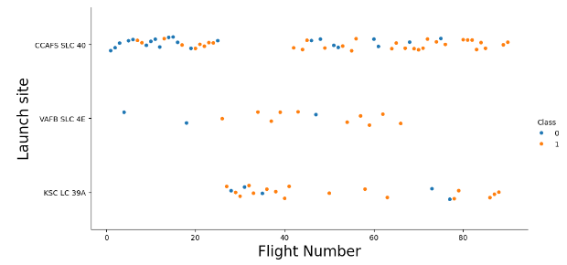
Flight Number vs. Launch Site
From this plot, it shows that the launch site with larger flight number has greater success rate.

Slide 19
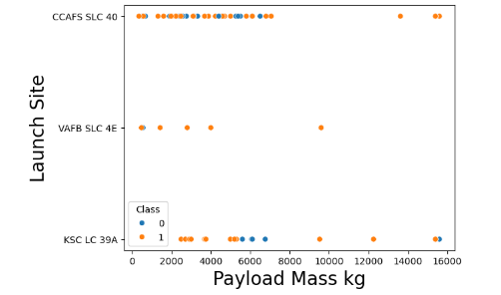
Payload vs. Launch Site
CCAFS SLC: The greater the payload mass is, the higher the success rate is.
VAFB SLC: Doesn’t have launched for heavy payload mass greater than 10000.

Slide 20
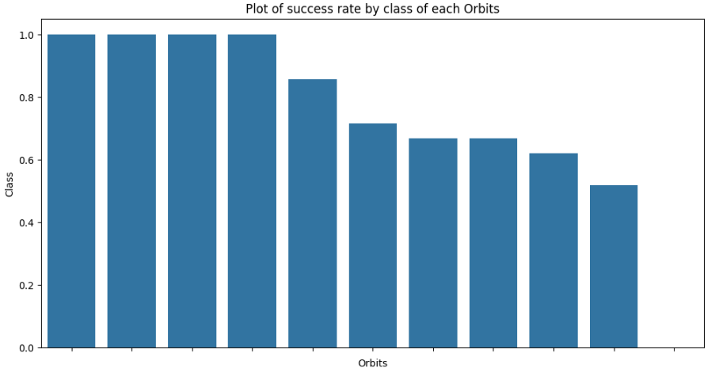
Success Rate vs. Orbit Type
we can see that ES-L1, GEO, HEO, SSO, and VLEO are the Orbits that have high success rate. The SO has the least success rate amongst the orbits

Slide 21
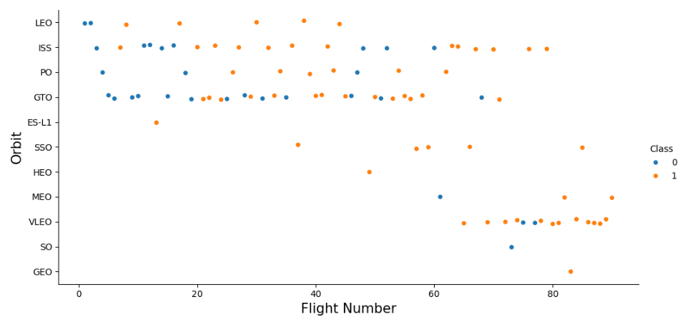
Flight Number vs. Orbit Type
LEO: The more the flight number has, the more the orbit is successful.
SSO: don’t have any relationship between Flight and Orbit type

Slide 22
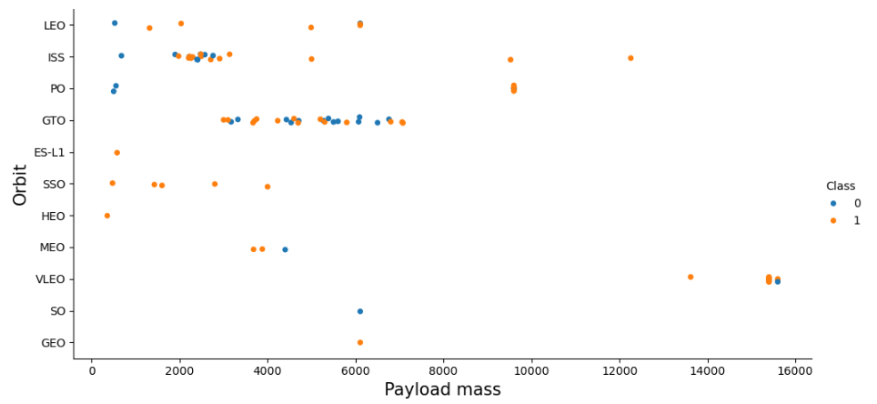
Payload vs. Orbit Type
LEO: The more heavier the Payload mass is, it is more successful
SSO: No relationship between payload and orbit type

Slide 23
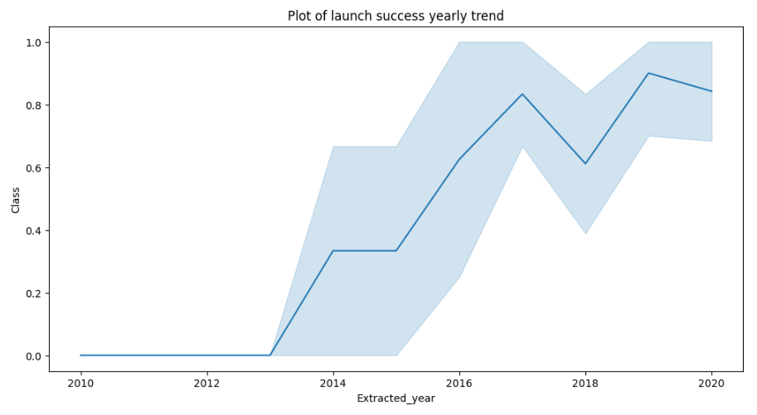
Launch Success Yearly Trend
We can observe that the sucess rate since 2013 kept increasing till 2020

Slide 24
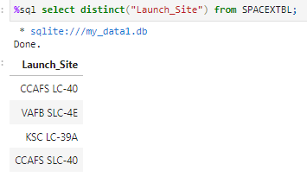
All Launch Site Names
Display the names of the unique launch sites by using Distinct

Slide 25
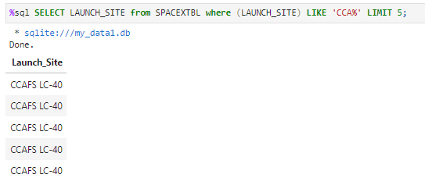
Launch Site Names Begin with 'CCA'
Display 5 records where launch sites begin with the string 'CCA‘ by using like ‘CCA%’

Slide 26
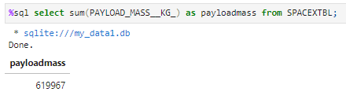
Total Payload Mass
Display the total payload mass carried by boosters launched by NASA (CRS) by using sum()

Slide 27
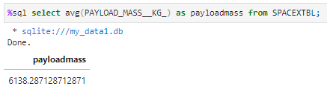
Average Payload Mass by F9 v1.1
Display average payload mass carried by booster version F9 v1.1 by using avg()

Slide 28
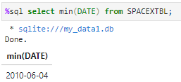
First Successful Ground Landing Date
List the date when the first succesful landing outcome in ground pad was achieved by using min(date)

Slide 29
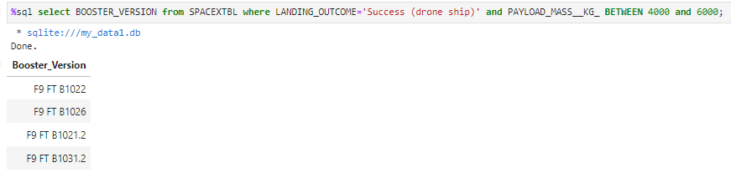
Successful Drone Ship Landing with Payload between 4000 and 6000
List the names of boosters which have successfully landed on drone ship and had payload mass greater than 4000 but less than 6000

Slide 30
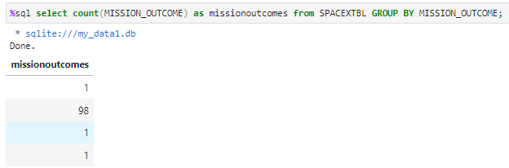
Total Number of Successful and Failure Mission Outcomes
Calculate the total number of successful and failure mission outcomes by using group by

Slide 31
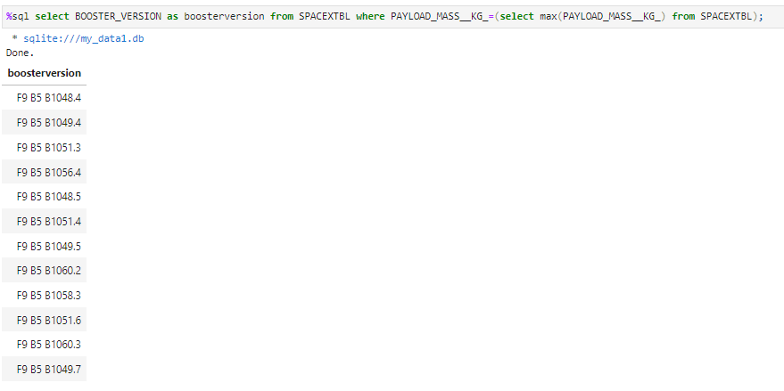
Boosters Carried Maximum Payload
List the names of the booster which have carried the maximum payload mass by using where PAYLOAD_MASS__KG_=(select max(PAYLOAD_MASS__KG_) from SPACEXTBL)

Slide 32
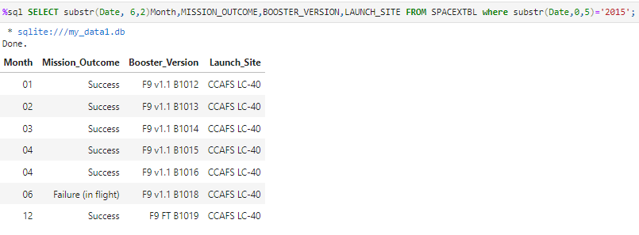
2015 Launch Records
List the failed landing_outcomes in drone ship, their booster versions, and launch site names for in year 2015 by using where substr(Date,0,5)='2015'

Slide 33
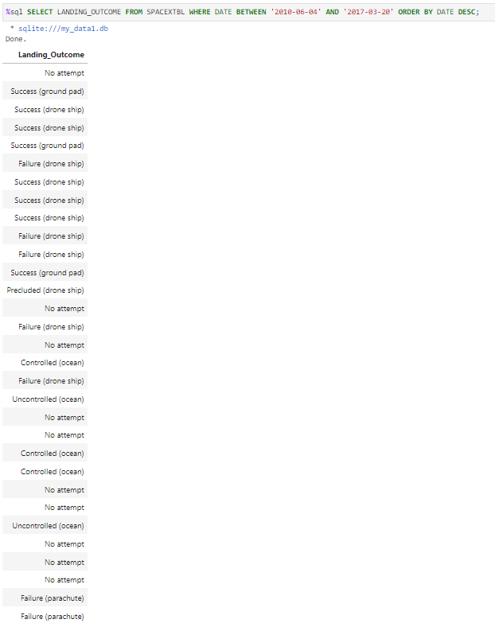
Rank Landing Outcomes Between 2010-06-04 and 2017-03-20
Rank the count of landing outcomes (such as Failure (drone ship) or Success (ground pad)) between the date 2010-06-04 and 2017-03-20, in descending order by using order by DATE DESC

Slide 34

Section 3

Slide 35
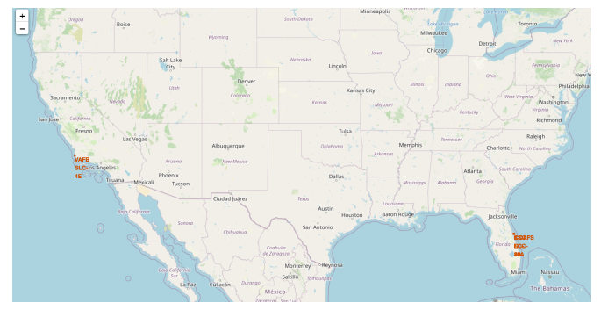
The generated map with marked launch sites
All launch sites are in very close proximity to the coast
All launch sites are in hot place

Slide 36
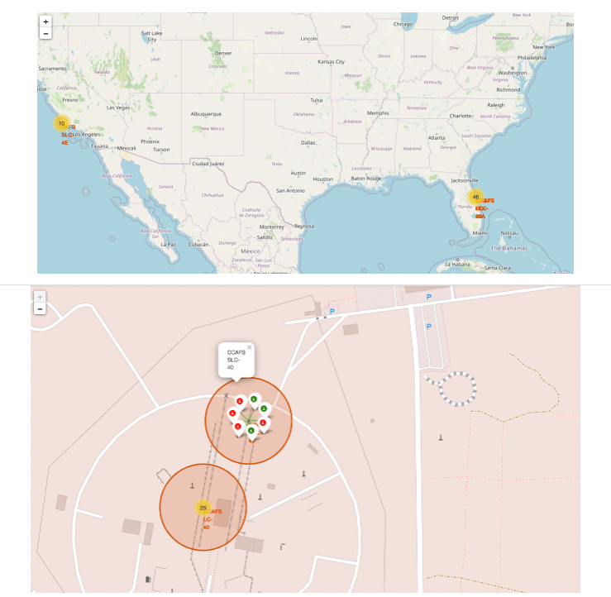
Mark the success/failed launches for each site on the map
Green marker represents success; red marker represents failed

Slide 37
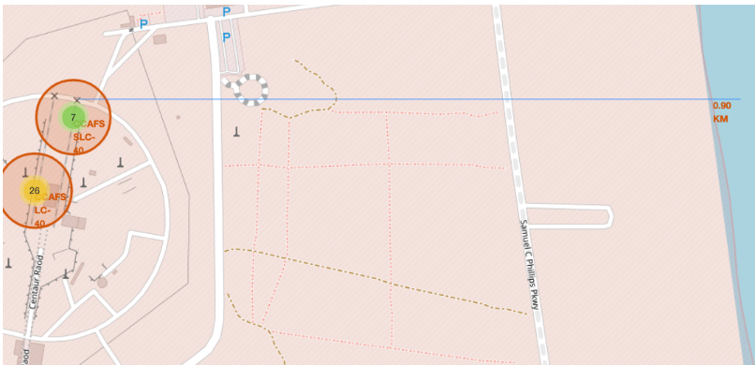
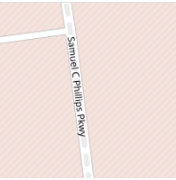


Calculate the distances between a launch site to its proximities

Slide 38

Section 4

Slide 39
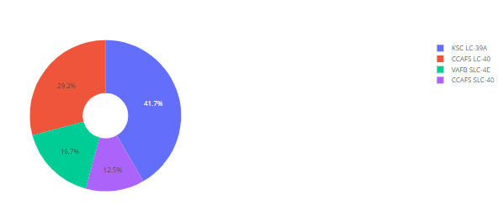
Total Success Launches By All sites
KSC LC-39 has the most success launches

Slide 40
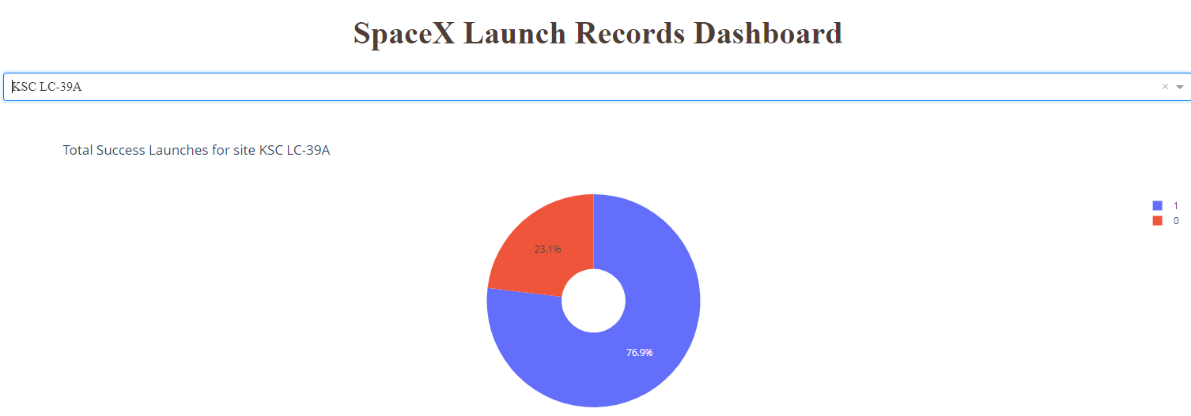
Total Success Launches for site KSC LC-39
The success rate is 76.9%

Slide 41
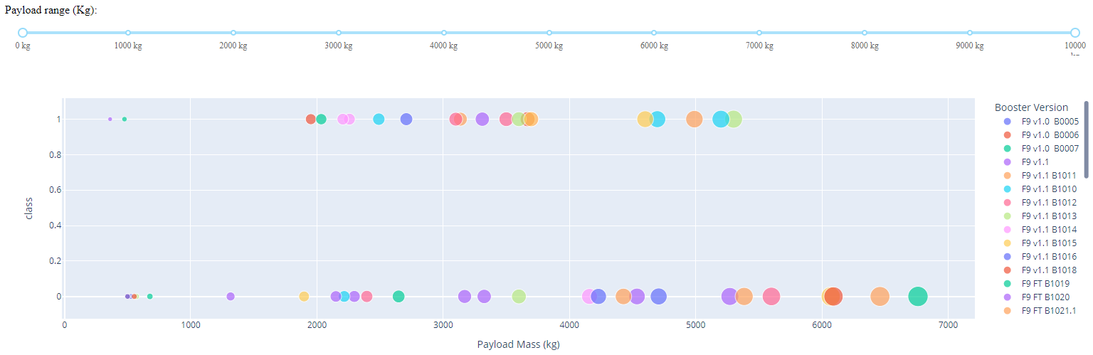
The Scatter Chart to show values for All sites
The most successful launches happened at Payload mass from 2900 to 5000kg.

Slide 42

Section 5

Slide 43
Classification Accuracy
The Decision Tree has the highest classification accuracy

Slide 44
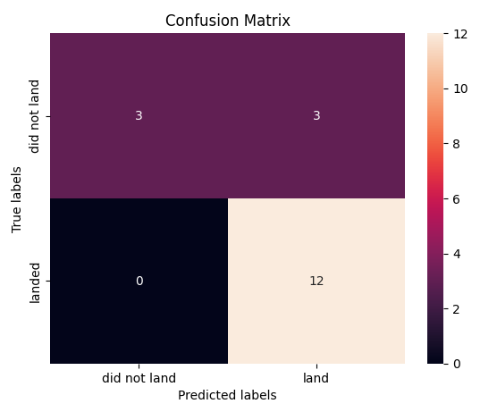
Confusion Matrix
Logistic regression can distinguish between the different classes, and he major problem is false positives

Slide 45
Conclusions
Data Collection API Lab
Data Collection with Web Scraping
Data Wrangling
EDA with SQL
Exploratory Analysis Using Pandas and Matplotlib
Interactive Visual Analytics and Dashboard
Predictive Analysis

Slide 46
Appendix
Include any relevant assets like Python code snippets, SQL queries, charts, Notebook outputs, or data sets that you may have created during this project

Slide 47


